Slide 1
Pollution Predictor
A Data Mining Project by 19BCP016 - Bhagvatsinh Jadeja 19BCP093 - Pathik Viramgama
19BCP137 - Vatsal Sevalia

Slide 2

Details on Project
Project Title: Pollution Predictor
Project Allocator: PDEU
Subject Name: Data Mining
Subject Code: 20CP306T
Group ID: DMP_27

Slide 3

Introduction
Pollution has been increasing on a daily basis in every country on earth. Air pollution is the major problem humanity is facing right now.
The Machine we made in this project basically predicts what the pollution will be next year when it is provided with previous year values.

Slide 4
Societal Challenges
Air Pollution cause many health-related issues such as lung cancer, infection in skin and hearing problem.
Air Pollution is responsible for global warming especially in developing countries like India, and China.
We tried to tackle this challenge by data mining model which will predict air toxicity level of next year from dataset containing past years air toxicity level.

Slide 5
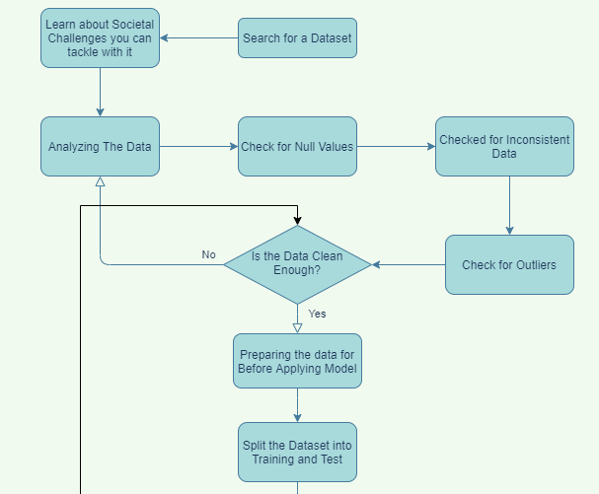
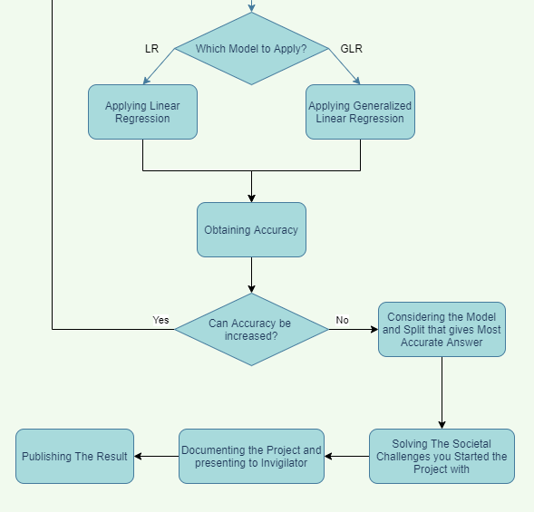
Architecture

Slide 6
Dataset
Data is sourced from Kaggle Datasets Collection published by Karl Weinmeister.
The dataset consists of around 2400 records of air pollution of major countries of the world for 8 years.
Link of the Dataset:
https://www.kaggle.com/kweinmeister/pm25-global-air-pollution-20102017

Slide 7
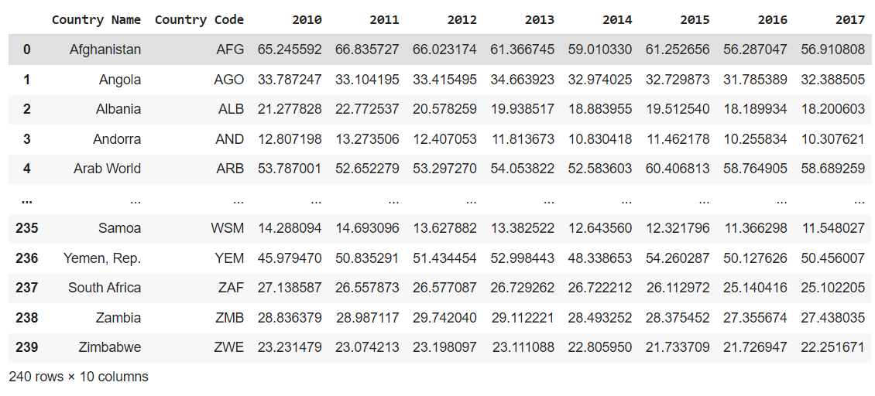
Dataset Details
The unit of Air pollution in the dataset is Mean Annual Exposure (Micrograms per Cubic Meter).

Slide 8
Data Preprocessing
We checked for 3 major points of data cleaning i.e. null values, outliers & inconsistent data. Moreover we checked for data duplicity.
So after preprocessing, our dataset is clean so it still contains 240 rows and 10 columns.

Slide 9
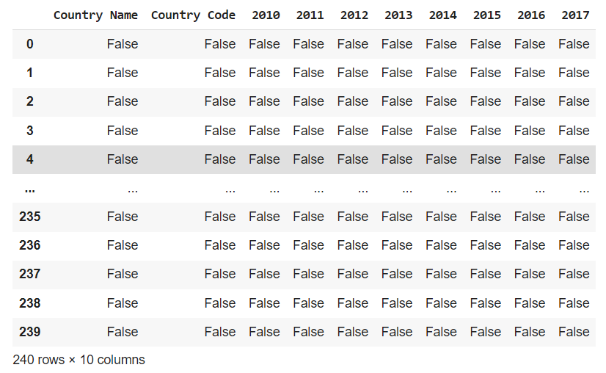
The False indicates if the data cell is not null
We checked for Null values and inconsistent data and the whole dataset passed the test.

Slide 10
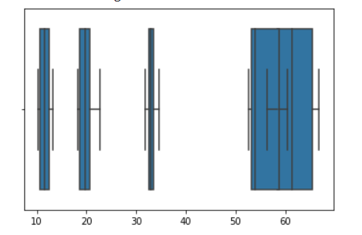
As we can see in the Graph no points lie outside the box plot values
Hence there are no outliers as well that can divert our model’s prediction

Slide 11
Pollution Predictor Model
The proposed system is capable of predicting the concentration of pollution in the Air for the year 2017 from the data of past years 2010 to 2016.
We have chosen Linear Regression as our model as it gave the best accuracy among others we implemented.

Slide 12
Pollution Predictor Model
The Model predicts the Air Pollution of 239 countries for the current year (2017) based on the previous 6 years (2010-2016) data for the same.
Model predicts the target attribute with an accuracy of at least 98%. This astounding accuracy is because the dataset is squeaky clean and the data, smooth. This was calculated using the r2_score function from sklearn.metrics library.

Slide 13
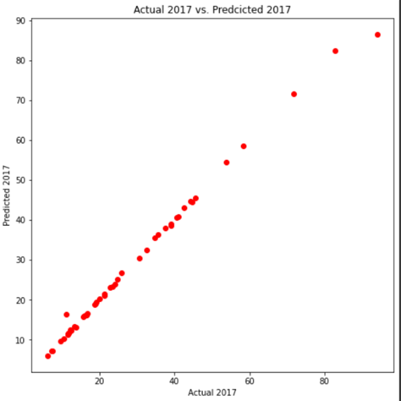
The function we get from plotting the graph is linear line Y = X. Most points lie near or on the graph.

Slide 14
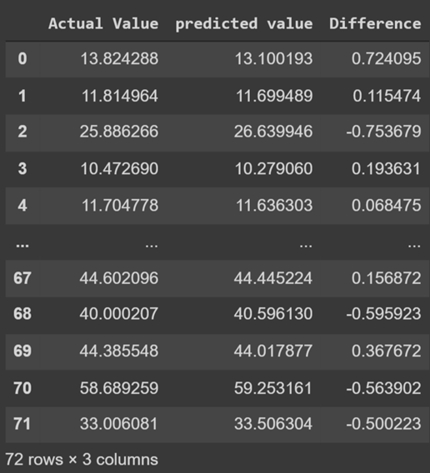
For the 30% test cases (72), following is the difference found per example. On Squaring and adding the difference and then taking square root, we get The RMS Error of 1.71 units. This was calculated using mean_squared_error function from numpy Library

Slide 15
Results
Our model successfully predicted every country's pollution for 2017.
After exploring different Models and Algorithm, we used Simple Linear Regression as our Model which gave us the best results
This Model Predicted the values of 2017 Pollution with an accuracy of at least 98% every time.
Dataset is squeaky clean. Hence the Mean Square Error that occurred was only 1.71 units.

Slide 16
Conclusion
We tried to make an accurate model to predict air pollution and hence tried to tackle the future prediction for the air pollution of different countries of the world so that we can take necessary steps starting from the present to secure the future and save mother earth.
Results we obtained were very promising. So we can say we solved our societal challenge of getting accurate data for Air Pollution Prediction and hence giving an advantage on decreasing the pollution in world by taking appropriate steps.

Slide 17
Thank You
19BCP016 - Bhagvatsinh Jadeja 19BCP093 - Pathik Viramgama
19BCP137 - Vatsal Sevalia

